Slide 1
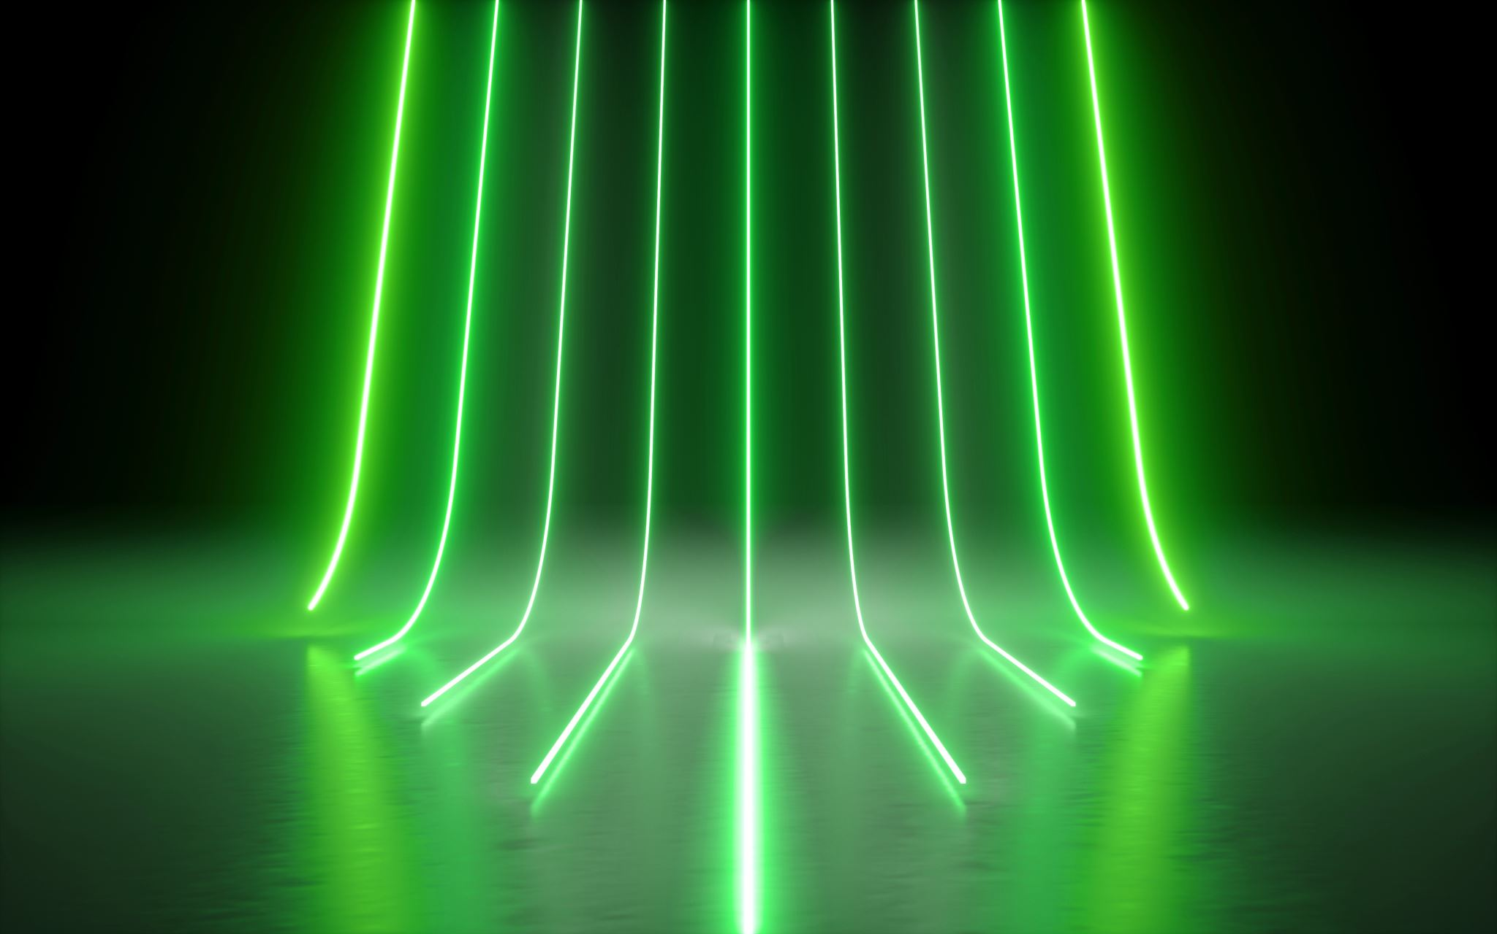
Devanagari Character Recognition
Minor Project Presentation
Project Guide:
Dr. Tejaswini M
Assistant Professor, CSE
Presentation By:
Abhishek Kumar(170101003)
Himanshu Ranjan(170101017)
Suraj Kumar(170101053)
Rashi Krishna(170102037)

Slide 2
Introduction
Character Recognition is the identification of printed characters from an image, a book, a handwritten note, cheques, or letters. It is similar to using a handheld scanner to read a barcode, or reading OMR exam sheets, but it can distinguish between different alphabets.
Character recognition enhances the processing of scanned images by allowing you to automatically recognize and extract text content from different data fields.

Slide 3
Devanagari Character Scripting
Devanagari is an Indic script and forms a basis for over 100 languages spoken in India and Nepal including Hindi, Marathi, Sanskrit, and Maithili. It consists of 47 primary alphabets, 14 vowels, and 33 consonants, and 10 digits. In addition, the alphabets are modified when a vowel is added to a consonant. There is no capitalization of alphabets, unlike Latin languages.
The aim is to create a software that can recognize characters from image of Devanagari text.
It is a growing area of research in the field of Pattern Recognition.

Slide 4
Problem
Most of the websites in Devanagari use images to represent text. There is a need to index such images based on the text in them so that they can be easily searched.
The aim of project is to develop software which can recognize Devanagari characters from scanned image of printed documents.
Image
Recognized Characters

Slide 5
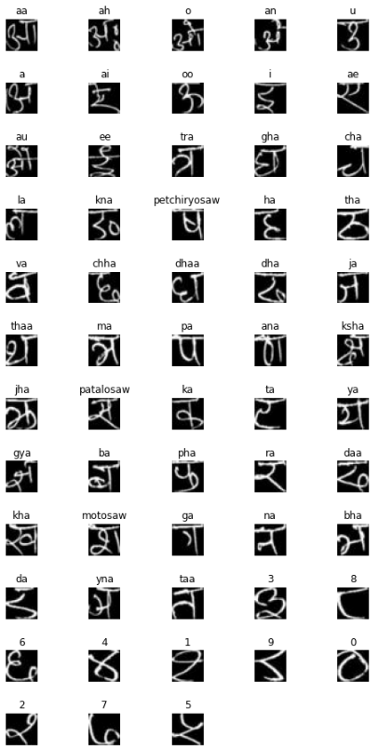
Dataset
The dataset contains labelled images of handwritten Devanagari characters.
The dataset contains 92 thousand images (32x32 pixels) of 58 characters, digits 0 to 9, vowels ‘a’ to ‘ah’ and consonants “ka” to “gya”.The images are in png format.
Some of the images in our dataset are shown below :

Slide 6
Tools Used
Python:
Python is a general-purpose high level programming language that is widely used in data science and for producing deep learning algorithms. Many developers use Python and its libraries like Numpy, Scipy, Pandas, Matplotlib; frameworks like Theano, TensorFlow, Keras.
Tensorflow:
TensorFlow is an end-to-end open source platform for machine learning. It has a comprehensive, flexible ecosystem of tools, libraries and community resources that lets researchers push the state-of-the-art in ML and developers easily build and deploy ML powered applications.
Python and tensorflow can be used to build a feed forward neural network for the same.
Keras: For our image classifier model we are using CNN. CNN can easily be implemented using keras.
Flask: Flask, a python web framework is used to build a web interface to deploy our CNN model.

Slide 7
Why CNN ?
One major advantage of using CNNs over NNs is that we do not need to flatten the input images to 1D as they are capable of working with image data in 2D. This helps in retaining the “spatial” properties of images.
Another important advantage of CNN is parameter sharing and reuse. This means instead of using a parameters = number of nodes on layer, CNN uses a fixed sized small filter. And our task is to find the best filter that can classify our characters with maximum accuracy.

Slide 8
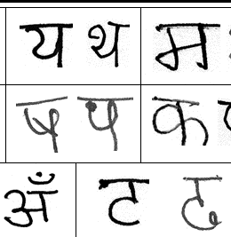
Character Recognition Process
Load Image from device
Image preprocessing
Text Recognition and noise removal
Character Segmentation
Character
Classifier
Storing
character in
text file

Slide 9
Preprocessing Images
Our dataset already contains images of size 32X32.
But for images of greater size we will need to first pre-process the image.
Apply gaussian filter to the image to make text wider.
Invert black and white because most of the image is white.
Scale down the value of each pixel. (Dividing by 255).

Slide 10
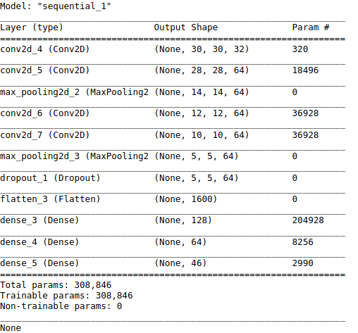
Convolution Neural Network
Our CNN model has :
4 convolution layers
2 pooling layer
1 dropout layer (with a 20% dropout percentage)
3 dense layer (including the output layer)

Slide 11
Segmentation
To predict a whole word we need to slice each character and pass it to our model. This process of slicing a word into its component character is segmentation.
Segmentation can be done simply with the help of white space between two characters. But problems may arise when dealing with characters like ‘ग’.

Slide 12
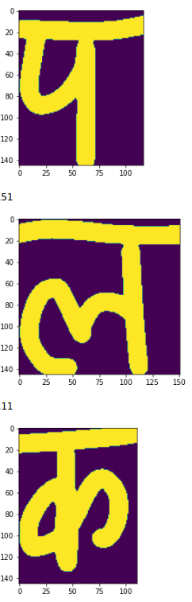
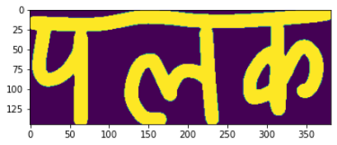
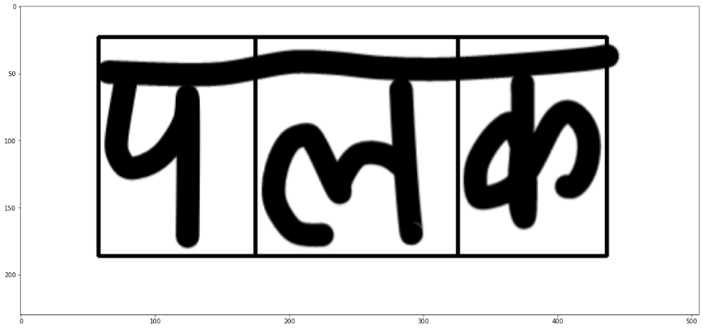
3 Steps of Segmenting
Image after preprocessing
Extracting individual characters
Recognizing individual Characters

Slide 13
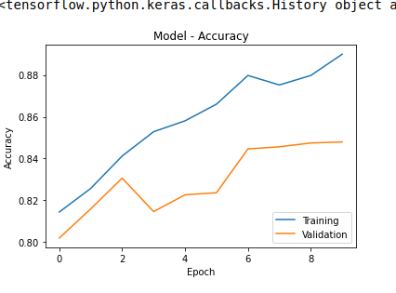
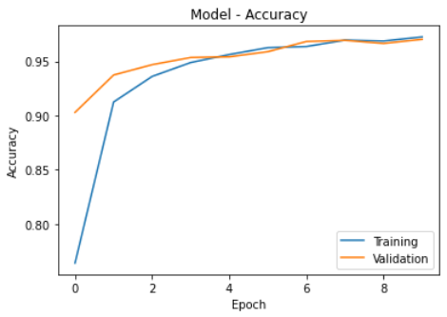
Evaluating Model Accuracy
Case of Overfitting
No Overfitting
Training our model for 100 epochs with batch size=32 gave good training accuracy but failed to produce good accuracy value for the testing set.
Running the model for 10 epochs with batch size=32, produced the following results.

Slide 14
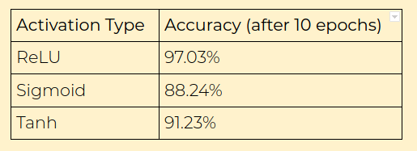
Evaluating Different Activation Function
ReLU activation function gives the best result and hence we will be using it to build our final model.

Slide 15
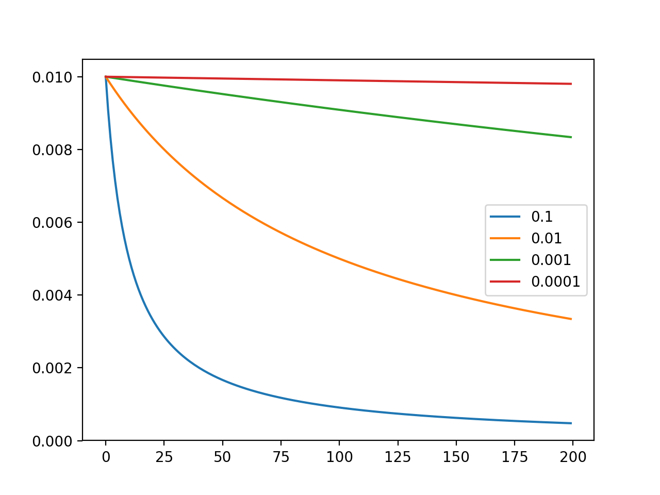

Effect of learning rate
A learning rate of ${10}^{−3}$ made our model to hardly learn anything.
As seen in the image the red line is just a straight line implying there is no decrease in loss with respect to epochs.
A learning rate of 0.1 gave just the desirable result, which we will be using to build our final model.
Loss v/s epochs for various learning rate

Slide 16
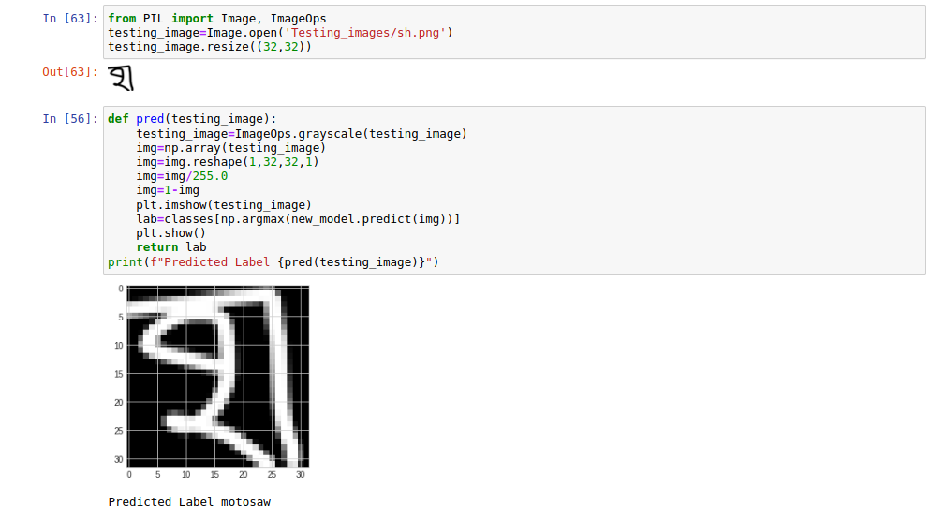
Working
Identifying individual characters :

Slide 17
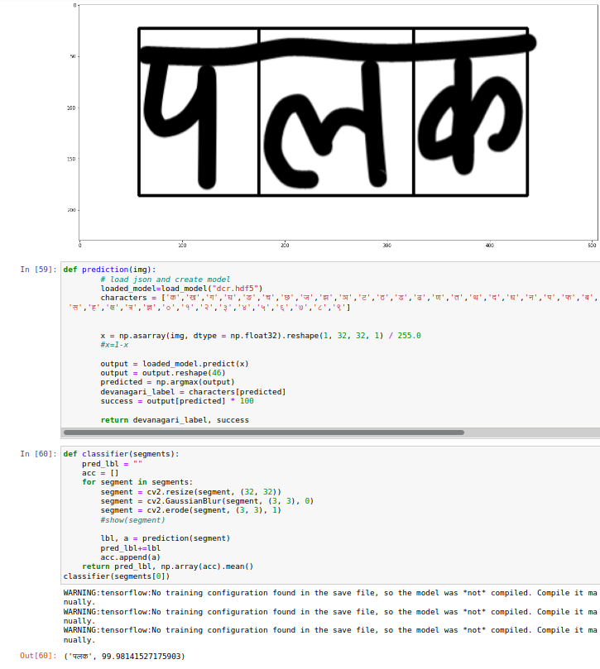
Working
Identifying whole words (in jupyter-notebook) :

Slide 18
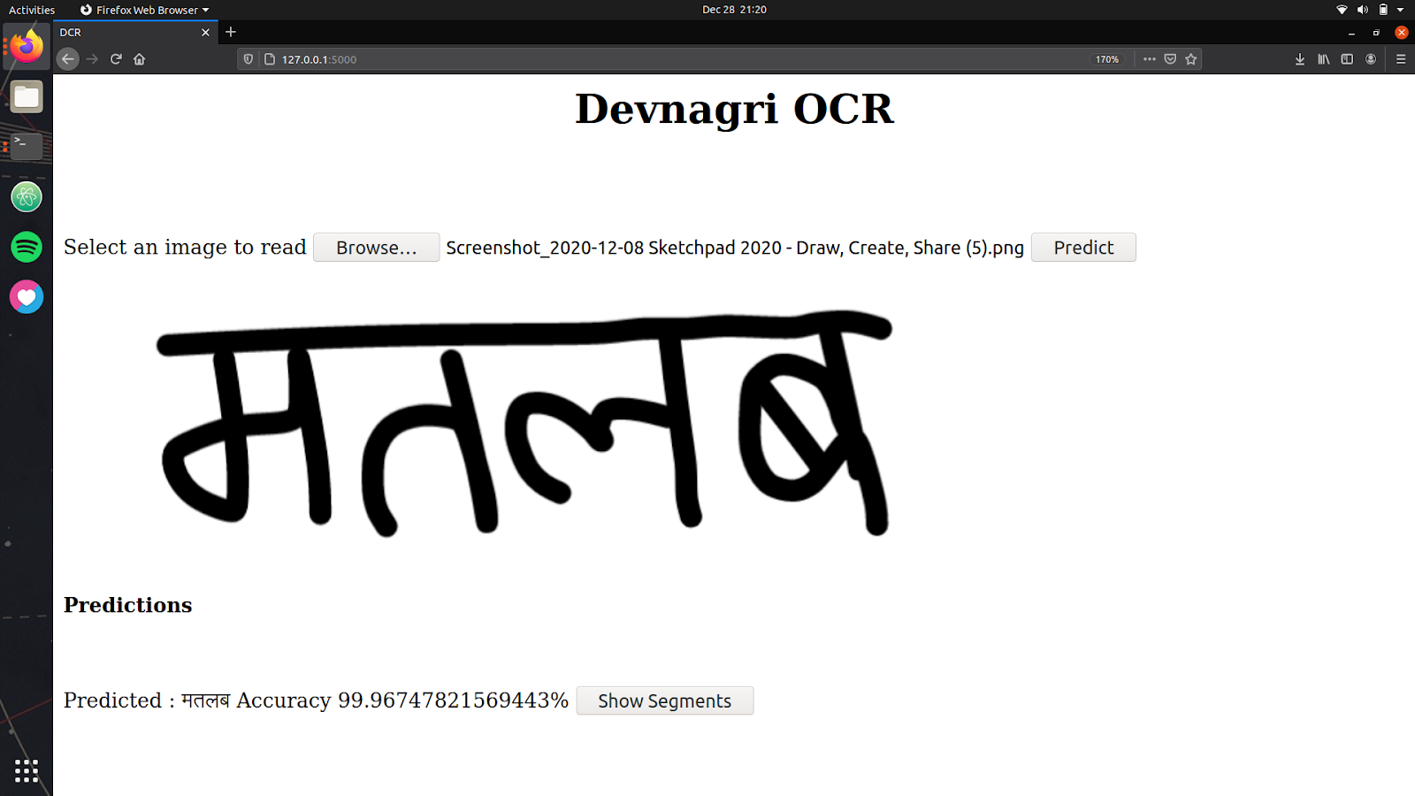
Working
Identifying whole words (in web application) :

Slide 19
Applications of Devanagari Character Recognition
Digitizing Books: It can be used to digitize books written in Devanagari. Digitizing of books can provide a large number of advantages such as searching through the book, cost reduction, and easy storage.
Indexing of Images in Search Engines: Most of the sites often use images to represent Devanagari text. There is a need of search engines which can search for keywords provided in Devanagari script. For the efficient functioning of these search engines it becomes necessary for them to include some software to recognize Devanagari text from websites.
Recognizing addresses on envelopes in post offices: use of such software could be in recognizing Devanagari addresses on envelopes in post offices, thus automating the overall process.
Use for those who don’t know Hindi : This software, if added with the capability of transliteration/translation can prove quite useful for many persons who don’t understand Hindi but want to read some book written in Hindi. It would allow the books to be easily translated into other languages.

Slide 20
Future Aspects
Online character Recognition
Printed Text Recognition
Language Recognition
Document Graphics Recognition
Document Understanding
Language Translator
Text to speech

Slide 21
Conclusion
Development in character recognition will boost word processing and image understanding.
Devanagari character recognition will help readers to listen to Indian literature using computers and PDA or ebook readers.
It will help in language translation which is complex problem in multilingual country like India where each state have its own language.

Slide 22


